Slide 1
Statistical Methods for Decision Making

Slide 2
Agenda:
1. Chi Square Test:
A. Test of Independence
B. Goodness of fit
C. Test of variance
3. Anova
A. One –Way Anova
B. Kruskal Wallis Test
C. Post hoc analysis ( Tukey HSD)
D. Two way -Anova

Slide 3
Chi-square

Slide 4
What is Chi-Square
The Chi Square statistic is commonly used for testing relationships between categorical variables.
The null hypothesis of the Chi-Square test is that no relationship exists on the categorical variables in the population. They are independent.

Slide 5
When Chi-Square
Dependent Var(y) | Independent Var(x) | Technique
Categorical | Categorical | Chi-Square
Continuous | Categorical | ANOVA
Continuous | Continuous | Regression

Slide 6
Important Terms
Parametric Tests
The tests in which the population constants like mean, standard deviation, standard error, correlation coefficient, proportion etc. are used and data tend to follow one assumed or established distributions such as normal, binomial, Poisson etc.
Non Parametric Tests
The tests in which no constant of population is used. Data do not follow any specific distribution and no assumptions is made in these tests. Eg. To classify good better and best we do not allot arbitrary numbers or marks to each category.
Hypothesis:
It is a definitive statement about population parameter.

Slide 7
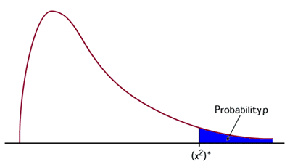
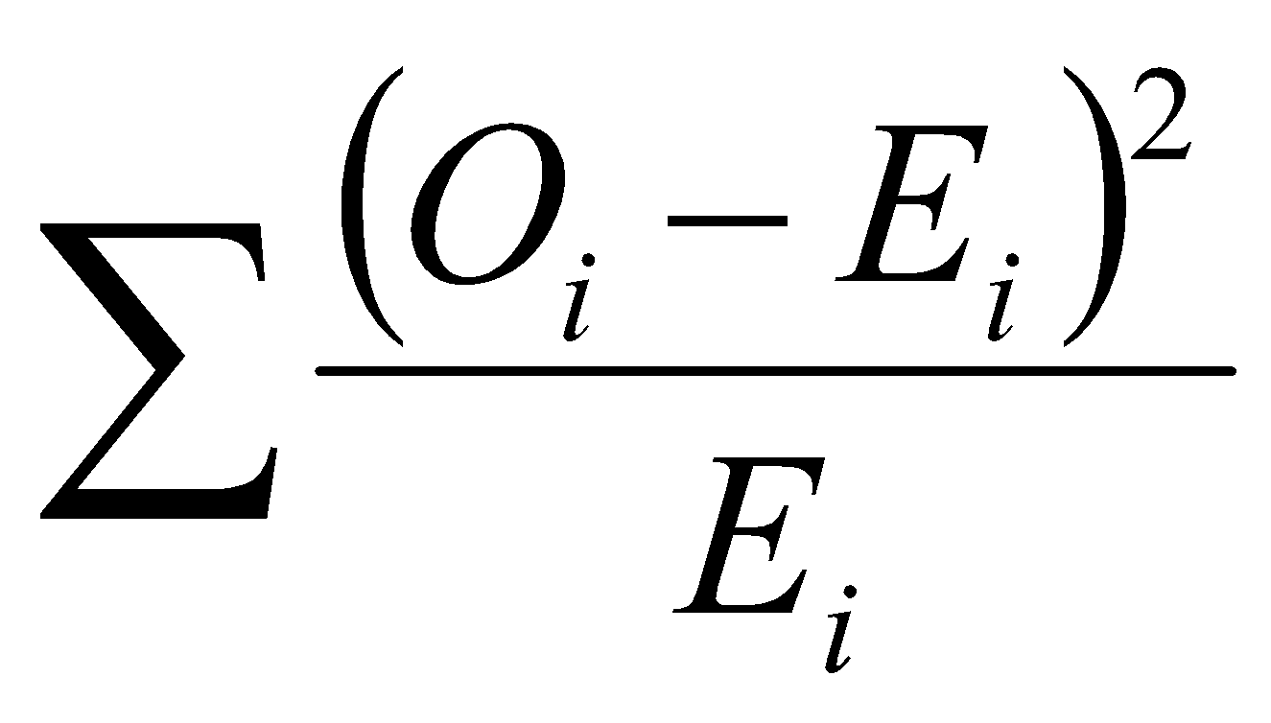
Chi Square (χ²) Test
The Chi Square test is a non-parametric Test
It tests relationship between two nominal variables
The statistic chi square is given by the equation and has a distribution as shown.
The conditions for using chi square
Data must be counts
The observations must be random and independent
None of the cells must have a count less than 5

Slide 8
Properties of Chi-Square Distribution
1. The mean and standard deviation of a chi-square distribution are k and √2k respectively, where k is the degrees of freedom.
2. As the degrees of freedom increases, the probability density function of a chi-square distribution approaches normal distribution.
3. Chi-square goodness of fit is one of the popular tests for checking whether a data follows a specific probability distribution.
4. Chi square test is a right tailed test.

Slide 9
Chi-square Goodness of fit tests
Goodness of fit tests are hypothesis tests that are used for comparing the observed distribution of data with expected distribution of the data to decide whether there is any statistically significant difference between the observed distribution and a theoretical distribution (for example, normal, exponential, etc.) based on the comparison of observed frequencies in the data and the expected frequencies if the data follows a specific theoretical distribution.
Null hypothesis: | There is no statistically significant difference between the observed frequencies and the expected frequencies from a hypothesized distribution
Alternative hypothesis | There is statistically significant difference between the observed frequencies and the expected frequencies from a hypothesized distribution.

Slide 10
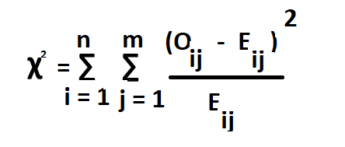
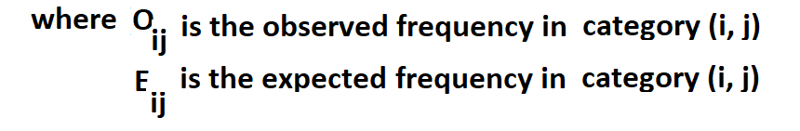
Chi-square Goodness of fit tests

Slide 11
Chi-Square One Way - Example
A1 airlines operated daily flights to several Indian cities. The operations manager believes that 30% of their passengers prefer vegan food, 45% prefer vegetarian food , 20% prefer non-veg food 5% request for Jain food.
A sample of 500 passengers was chosen to analyse the food preferences and the data is shown in the following table:
Food type | Vegan | Vegetarian | Non-Vegetarian | Jain
Number of passengers | 190 | 185 | 90 | 35

Slide 12
Solution
Null hypothesis : Probability distribution of the food preference is P(Vegan) = 0.30, P(Veg) = 0.45
P(Non-veg) = 0.20 P(Jain) = 0.05
Alternative hypothesis : Probability distribution of the food preference is not defined in the null hypothesis.

Slide 13
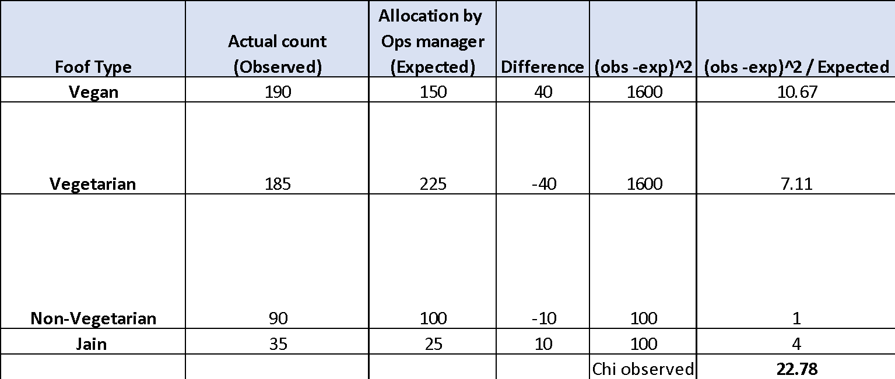
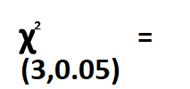
Chi-Square - Calculation
7.814728
df = 4 -1 = 3
Since the chi-square calculated value > critical value, we reject the null hypothesis.
We conclude that probability distribution of the food preference is not defined in the null hypothesis

Slide 14
Chi-square Two Way
Example: A Cable service provider company is interested in checking whether or not the customer churn depends on customer segment. Use 5% as level of significance.
Customer Segment | Churned | Retained | Total E
S1 | 15 | 142 | 157 157*69 /1000
S2 | 24 | 400 | 424
S3 | 30 | 389 | 419
Total | 69 | 931 | 1000

Slide 15
Chi-square tests of independence
Null hypothesis: | Customer segments and customer churn are independent
Alternative hypothesis | Customer segments and customer churn are not independent.
Customer Segment | Class | O_{ij} | E_{ij} = Row sum X col sum / Total Sum | Oij - Eij | O -E)^2 / E
S1 (I =1) | Churned (j = 1) | 15 | 11 | 4 | 1
S2 (I =2) | Churned (j = 1) | 24 | 29 | -5 | 1
S3 (I = 3) | Churned (j = 1) | 30 | 29 | 1 | 0
S1 (I =1) | Retained (j =2) | 142 | 146 | -4 | 0
S2 (I =2) | Retained (j =2) | 400 | 395 | 5 | 0
S3 (I = 3) | Retained (j =2) | 389 | 390 | -1 | 0
 |  |  | 1000 | 0 | 2
degrees of freedom = (r -1 ) * (c - 1)
= (3- 1) ( 2 - 1) = 2 ; > qchisq(.95, df=2)
[1] 5.991465
Chi Observed = 2
Chi critical for alpha 0.05 and DoF = 2 is 5.99
We accept the null hypothesis.
We conclude that customer segment and customer churn are independent.

Slide 16
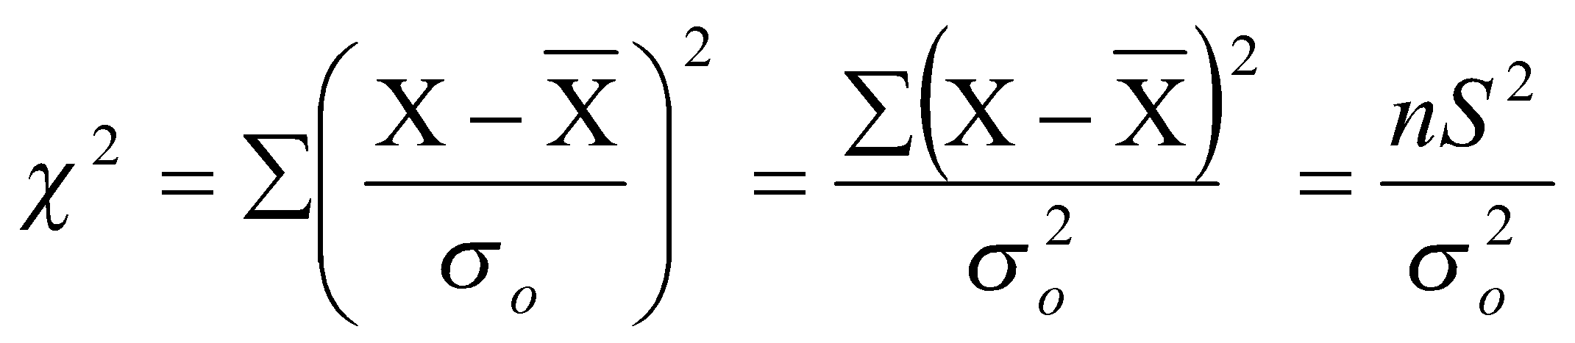
Test for Variance
Suppose we want to test whether the population has a given variance σ₀², then:
H_{o}: σ² = σ₀²
H_{A}: σ² ≠ σ₀²
and
If the calculated value lies between K₁ and K₂ then H_{o} is accepted. (K₁ and K₂ values are read from the table).

Slide 17
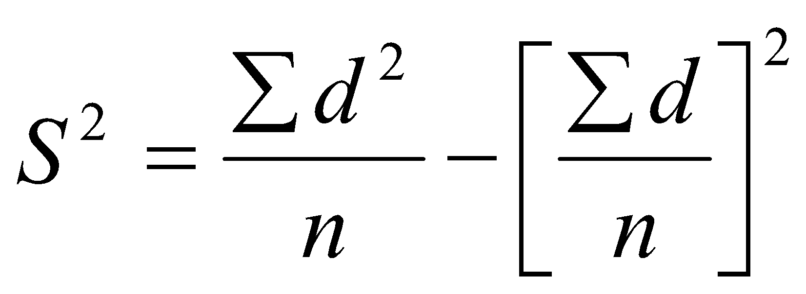
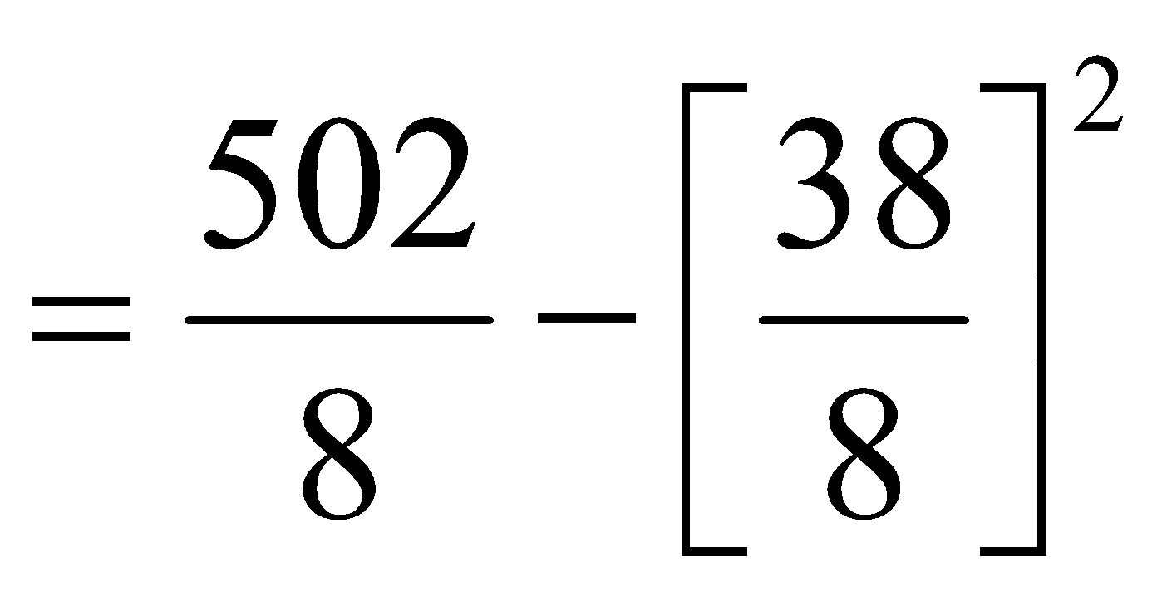
Example 1
The standard deviation of heights of plants is known to be 2 cms. Eight randomly selected plants have heights 172, 156, 154, 163, 170, 169, 170 and 164 cms. Test whether the sample standard deviation differs significantly?
Solution: Table
X | d = X - 160 | d²
172 | 12 | 144
156 | - 4 | 16
154 | - 6 | 36
163 | 3 | 9
170 | 10 | 100
169 | 9 | 81
170 | 10 | 100
164 | 4 | 16
 | 38 | 502
= 40.1875
∴ nS² = 321.5

Slide 18
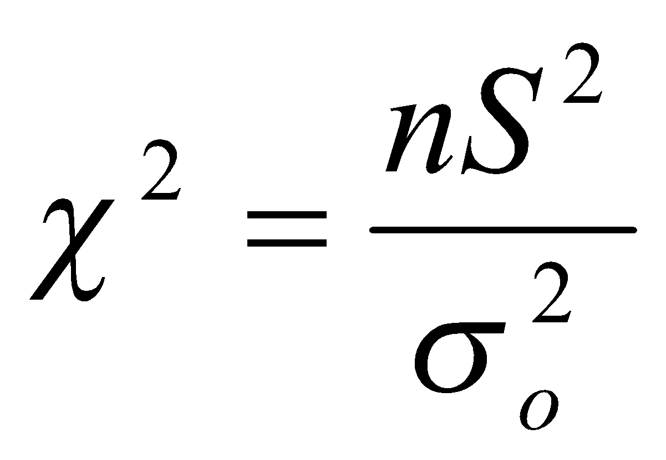
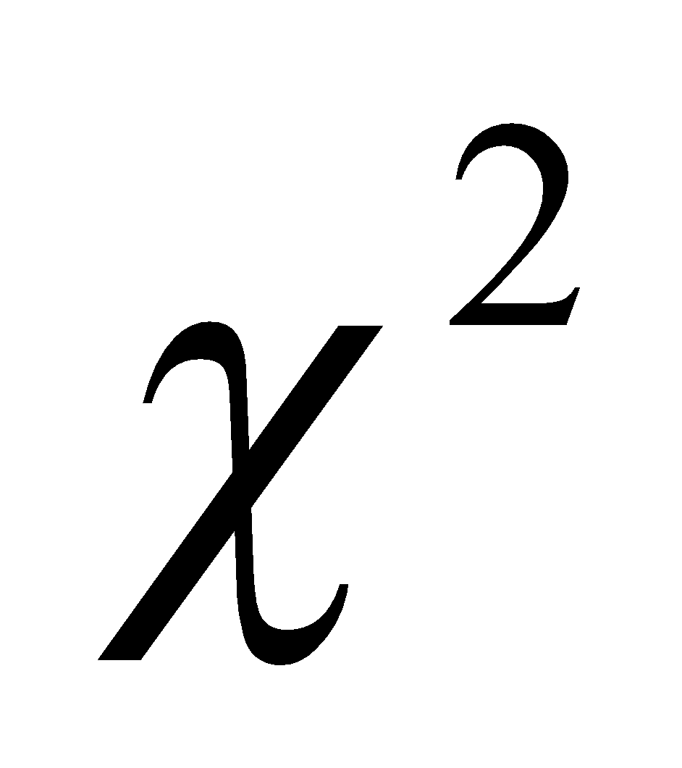
Steps for the Test of Variance
Null hypothesis H_{o}: σ₀² = σ²
Alternate hypothesis H_{A}: σ₀² ≠ σ²
Level of Significance 5% and D.O.F (8 – 1) = 7 ⇒ K₁ = 1.69 K₂ = 16.01
Test Statistics
Test _{cal} = 321.5 / 4 = 80.375
Conclusion: Since _{cal} lies outside K₁ and K₂, H_{o} is rejected.
⇒ Sample S.D differs significantly.

Slide 19
ANOVA

Slide 20
What is ANOVA?
Analysis of variance (ANOVA) are the methods designed to compare multiple populations, or groups.
Sir Ronald A. Fisher in 1920’s used ANOVA in his experimental design.
In ANOVA, you take samples from each group to examine the effects of differences among two or more groups.
The criteria that distinguishes the groups are called factors of interest.
Factors contain levels.

Slide 21
When Anova
Dependent Var(y) | Independent Var(x) | Technique
Categorical | Categorical | Chi-Square
Continuous | Categorical | ANOVA
Continuous | Continuous | Regression

Slide 22
ANOVA Introduction
Analysis of Variance is a statistical procedure that can be used to test if significant differences exists in the means of different populations.
Consider three populations with means µ₁, µ₂, µ₃ respectively. Using sample results we can set up the following NULL and ALTERNATE hypotheses.
Test:
If µ₁, µ₂, µ₃ are means three populations then
H₀ : µ₁ = µ₂ =µ₃
H_{a} : µ₁ ≠ µ₂ ≠ µ₃
ANOVA is used to determine whether the observed differences in the sample means are large enough to reject the NULL hypothesis.

Slide 23
ANOVA Assumption
For each population, the response variable is normally distributed
The variance σ² of response variable is same for all the distributions.
The observations are independent of each other.

Slide 24
ANOVA Conceptual Overview
Sample means are close together when they come from one population when H₀ is true
X₁
µ
X₂
X₃
Sample means are not close together when they come from different populations when H₀ is not true
X₁
µ₁
µ₂
X₂
X₃
µ₃

Slide 25
ANOVA Conceptual Overview
Consider 3 populations with means µ₁, µ₂, µ₃ respectively and we have drawn one sample of size n from each.
If the means of the three populations are equal, we would expect sample means to be close together.
More the sample means differ more is the evidence that sample means differ.
In other words if variability amongst the sample means is small it supports NULL hypothesis, otherwise it supports H_{a}
If null hypothesis is true, then we can consider that each sample came from same normal distribution. In this case mean and variance would be
= (µ₁+µ₂+µ₃) and Var (σ²) = n(σ_{x̄}²)
This is called between treatments estimate.
(continued)

Slide 26
ANOVA Conceptual Overview
When H₀ is false, we have three sampling distributions. The means are not close together and the variance S_{x̄}² will be larger causing σ² to be larger.
In this case the pooled variance estimate is applied. Therefore
Var (σ²) = (s_{x̄}²+ s_{x̄}² +s_{x̄}² )/3
This is called within treatments estimate.
The ratio of between treatments estimate to within treatment estimate is called F ratio.
Larger the F ratio, more is evidence that the populations differ.

Slide 27
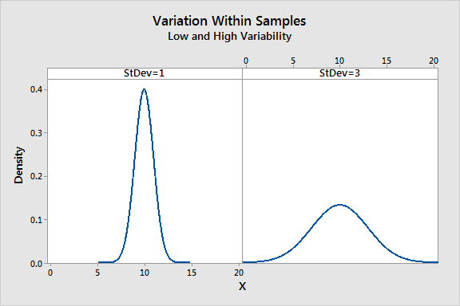
ANOVA F Value
Total variance is calculated within the group and across the group.
It’s the ratio of 2 variance
Variance are measure of desperation, how far data is moved from the mean
Larger value represents greater dispersion
F = Between the groups / Within groups
Larger the ratio, more likely it is that group have different mean (reject H0)

Slide 28
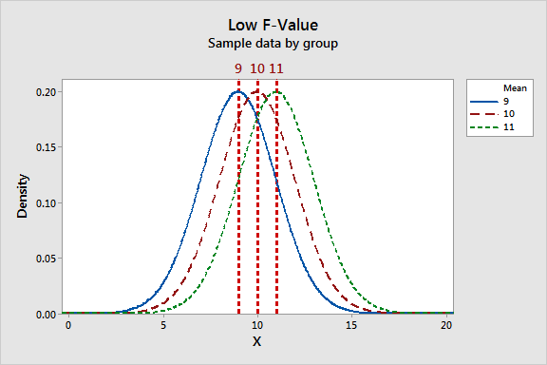
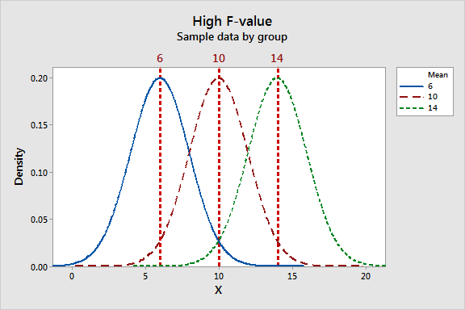
ANOVA F value : High/Low
Lower the f value, group means are
Close together with low variability
Within each group
The high F-value graph shows a case where the variability of group means is large relative to the within group variability.

Slide 29
Anova Treatment example
Example, let take the growth/yield of vegetable given based on fertilizer and after applying different types of fertilizers

Slide 30
Anova Before Treatment
There is no difference in the yield measure across 3 different ploughing area. Mean is same across all.

Slide 31
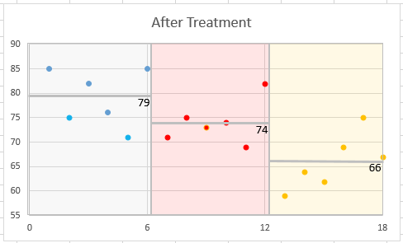
Anova After Treatment
Three different Ploughing area applied with fertilizers are showing different in the mean, this effect is called after treatment.

Slide 32
One Factor ANOVA
In one-way ANOVA, we partition the total variation as follows:
a. Variation due to differences among the groups (SSA), meaning it measures differences from group to group
b. Variation due to differences within the groups (SSW), meaning it measures random variation
Total Variation (SST)
Degrees of freedom= n -1, where n is the number of values in the group
Within Group Variation (SSW)
Degrees of freedom = c – 1, where c is the number of groups
Among Group Variation (SSB)
Degrees of freedom = n - c
Partitioning the total variation, SST = SSA + SSW

Slide 33
One Way Anova
Let us assume that there are c groups representing populations whose values are randomly and independently selected with mean 𝜇, 𝜇2, ..., 𝜇c follow a normal distribution, and have equal variances.
Null hypothesis states that there are no differences in the population means.
H₀: 𝜇₁ = 𝜇₂ = 𝜇₃ = ... = 𝜇_{c}
Alternative hypothesis states that at least one population mean is different from the other population means.
H_{A}: Not all 𝜇_{i} are equal (where i = 1, 2, ..., c).

Slide 34


ANOVA Introduction
Let X_{ij} is the i^{th} value in group j
n is the number of values in all the groups combined
c is the number of groups
J = (1,2,…, c) and i = (1,2,…, j)
nj is the number of values in group j and is the sample mean of group j
Grand mean = = ∑ ∑ (X_{ij} – X)² / n
When you divide these sum of squares by its respective degrees of freedom, we get the mean squares.
Total variation | Among group variation | Within group variation
SST = ∑_{j} ∑_{i} (X_{ij} – )² | SSA = ∑_{j} n_{j} ( – )² | SSW = ∑_{j} ∑_{i} (X_{ij} – )²
Mean squares* MST | Mean squares MSA | Mean squares MSW
MST = SST / (n – 1) | MSA = SSA / (c - 1) | MSW = SSW / (n – c)

Slide 35
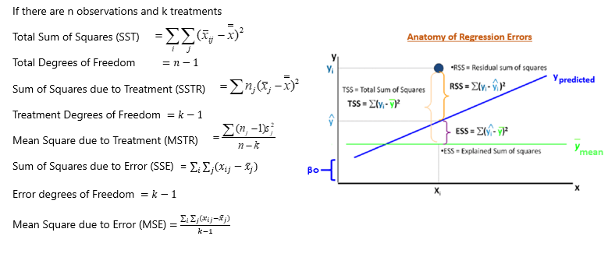
ANOVA Terminology

Slide 36
ANOVA Table
Analysis of Variance
Source of Variation | Degrees of Freedom | Sum of Squares | Mean Square Error | F | P
Treatment | k - 1 | SSTR | MSTR = SSTR/(k-1) | MSTR/MSE
Error | n - k | SSE | MSE = SSE/(n-k)
Total | n - 1 | SST
Factorial ANOVA is used when the experimenter wants to study the interaction effects among the treatments

Slide 37
One way ANOVA Business Case study
Business Case:
An operations manager wants to buy a new machine. He has been using 3 models and would like to go for one which produced minimum % no. of defects. He collected the following data:
% Number of defects produced
Machine 1 | Machine 2 | Machine 3
15 | 10 | 17
14 | 14 | 12
20 | 9 | 14
15 | 10 | 15
16 | 11 | 12

Slide 38
One way ANOVA Business Case study
Solution

Slide 39
One way ANOVA Business Case study
Solution

Slide 40
One way ANOVA Business Case study - Inference
F observed > F critical, so H0 is rejected. There is significant different in the types of machines.

Slide 41
Bangalore | Mumbai | Chennai
Hypothesis testing for center (Fstatistic _column)= MSC/MSE
Ho: Mu_Blr = Mu_Mum = Mu_Chennai
H1: Mu_Blr!= Mu_Mum !=Mu_Chennai
Hypothesis test for Batches (Fstatistic _row) = MSR/MSE
H0: Mu_April = Mu_May= Mu_June
H1: Any two means are not equal
Dof _column = c-1
Dof _rows = r-1
SSR = Sum ( xibar- xbar bar) ^2
SST = Sum( xij – Xbarbar) ^2

Slide 42
Two Way ANOVA
Two-way classification is a mere extension of the one-way ANOVA.
You have two factors for which the population means have to be compared.
The testing procedure is exactly the same as One-way ANOVA except for the fact that you will be testing the population means for two factors.
Rows are treated as blocks and columns as treatments.
Two-way ANOVA is called as Randomized Block Design in experimental design parlance.

Slide 43

Two Way ANOVA Calculation
Total Sum of Squares (TSS) =
Column Sum of Square (CSS) = n X ∑ (X_{j} – X)²
Row Sum of Square (RSS) = m X ∑ (X_{i} – X)²
Error Sum of Squares (ESS) = TSS – CSS - RSS
Where,
Xij is the observation corresponding to row j and column I
X is the overall mean (Grand mean)
Xj is the j^{th} column mean
Xi is the i^{th} row mean

Slide 44
Two Factor Anova Summary table
Source of Variation | Sum of Squares | Degrees of Freedom | Mean Squares | F
Factor A | SSA | r – 1 | MSA = SSA /(r – 1) | MSA MSE
Factor B | SSB | c – 1 | MSB = SSB /(c – 1) | MSB MSE
AB (Interaction) | SSAB | (r – 1)(c – 1) | MSAB = SSAB / (r – 1)(c – 1) | MSAB MSE
Error | SSE | rc(n’ – 1) | MSE = SSE/rc(n’ – 1)
Total | SST | n – 1

Slide 45
Two Way Anova Case Study
Business Case:
A super market has a chain of 5 stores. The General Manager is seriously concerned about quality of service at each stores. He conducted a survey on customer perceived quality on each day of the week.
Customer Rating on quality
Week Day | S1 | S2 | S3 | S4 | S5
MON | 79 | 81 | 74 | 77 | 66
TUE | 78 | 86 | 89 | 97 | 86
WED | 81 | 87 | 84 | 94 | 82
THU | 80 | 83 | 81 | 88 | 83
FRI | 70 | 74 | 77 | 89 | 68

Slide 46
Two Way Anova Case Study - Solution

Slide 47
Two Way Anova Case Study - Solution
Inference : Fact 1 and 2, F observed is greater than F critical, reject H0 and Accept Ha.
Hence it proved, customer feed back quality varied based on the day and store

